Slide 1
Chapter 1
Introduction to Spring Framework

Slide 2
Agenda
Framework
Why Java Framework?
Java Frameworks Trends
Spring Framework
Why? Features and Benefits
Spring Modules
Spring Core module
Types of container
Beans
Dependency Injection
Configuration Bean

Slide 3
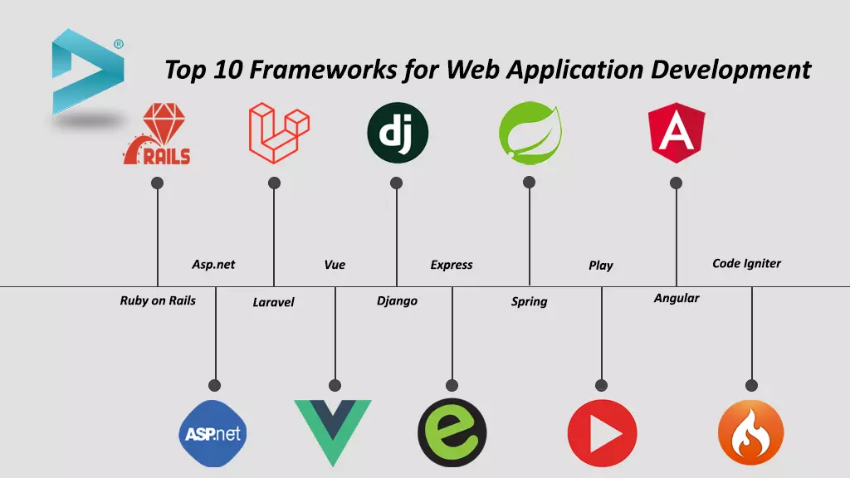
Framework :
Frameworks are large prewritten code to which you add your own code to solve a problem in a specific domain.
Software frameworks may include support programs, compilers , code libraries , tool sets , API , Function, Producer , Datafile.
Notes:
Frameworks can help and streamline the entire development process, they are widely available, and there is a large selection of them. Proper use of them will undoubtedly make application development more effective and enjoyable. Before choosing them, it is worth knowing what you are looking for and what you need, and with the right choice, they can be irreplaceable.

Slide 4
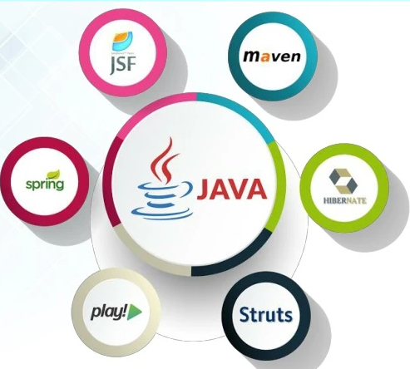
Why Java Framework?
Complexity
Heavyweight Components
High resource consumption
Complicated deployment descriptor files
Deployment Complexity
Long Development cycle
Monolithic Architecture
Session Management Challenges
Complex security models
Notes:
Complexity
Steep Learning Curve: J2EE's extensive specifications and numerous APIs can be overwhelming for developers, especially those new to enterprise-level Java.
Configuration Management: The need to configure various components like EJBs, JMS, JNDI, and more can be cumbersome and error-prone.
2. Performance Overhead
Heavyweight Components: Components like Entity Beans can introduce significant performance overhead due to their complexity and the associated container services.
Resource Consumption: J2EE applications can consume substantial system resources, impacting performance, especially under high loads.
3. Deployment Complexity
Deployment Descriptor Issues: Managing and maintaining the XML-based deployment descriptors can be tedious and error-prone.
Container Dependencies: J2EE applications are tightly coupled to specific application servers, which can lead to deployment challenges and difficulties in porting applications across different servers.
4. Debugging and Troubleshooting
Complex Stack Traces: Debugging J2EE applications can be challenging due to complex stack traces and the involvement of multiple layers and components.
Distributed Systems: Debugging issues in distributed systems involving multiple servers, databases, and services can be particularly difficult.
5. Development Speed
Boilerplate Code: Writing and maintaining boilerplate code for tasks like database access, transaction management, and security can slow down development.
Long Development Cycles: The complexity and extensive configuration requirements can lead to longer development cycles compared to more modern frameworks.
6. Scalability Issues
Monolithic Architecture: Traditional J2EE applications often follow a monolithic architecture, which can hinder scalability and make it difficult to update or scale individual components.
Session Management: Managing user sessions in a scalable manner, especially in distributed environments, can be challenging.
7. Vendor Lock-In
Proprietary Extensions: Some J2EE application servers provide proprietary extensions, leading to vendor lock-in and difficulties in migrating to different servers.
Inconsistent Implementations: Differences in how application servers implement the J2EE specifications can lead to portability issues.
8. Obsolescence
Outdated Technologies: Some J2EE technologies, like Entity Beans, have become outdated and are replaced by more modern alternatives like JPA (Java Persistence API).
Lack of Modern Features: J2EE may lack some of the modern features and conveniences found in newer frameworks like Spring or Jakarta EE.
9. Security
Configuration Vulnerabilities: Misconfiguration of security settings can lead to vulnerabilities.
Complex Security Models: Implementing and managing complex security models can be difficult and prone to errors.
10. Integration Challenges
Interoperability: Integrating J2EE applications with other systems, especially those using different technologies, can be challenging.
Middleware Complexity: Using middleware for integrating different J2EE components or other systems can add to the complexity.

Slide 5
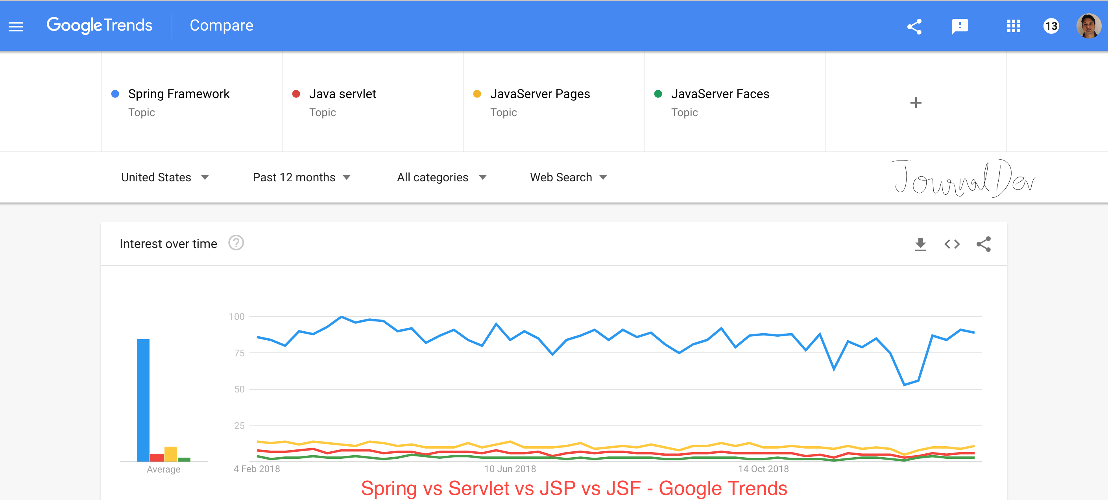
Java Framework Trends
Notes:
Reading : https://tecnoesis.wordpress.com/tag/problems-with-j2ee/
Efficiency, Security, Expense, Support are main features of java Framework

Slide 6
Spring Framework
Spring is one of the most popular frameworks for Java enterprise edition.
Developers all over the world use Spring for developing reliable and high-quality applications.
The spring framework was designed by Rod Johnson.
Since then Spring has become an alternative technology in Java world for the EJB model.
You can create different kinds of applications using the spring framework.
Open source Java platform since 2003.
Reduces code and speeds up development.
Spring enables to build applications from “plain old Java objects” (POJOs) and to apply enterprise services non-invasively to POJOs.
This capability applies to the Java SE programming model and to full and partial Java EE.
Current Spring version is 6.1

Slide 7
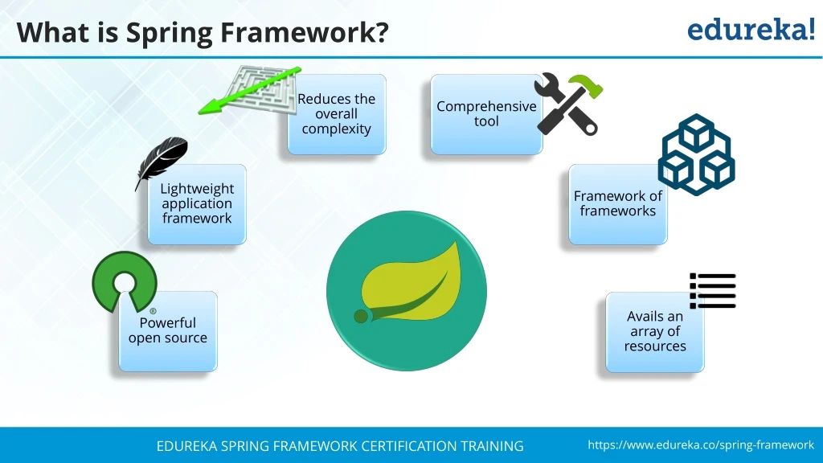
Spring Features
Spring is Noninvasive in nature: That means you don't need to extend any classes or implement any
interfaces to your class.
Spring is versatile: That means it can integrated with any existing technology in your project.
Spring provides end to end project development: That means we can develop all the modules like business layer, persistence layer.
Spring is light weight: That means if you want to work on particular module then , you don't need to learn complete spring, only learn that particular module(eg. Spring Jdbc, Spring DAO)
Spring supports dependency injection.
Spring supports multiple project development
eg: Core java Application, Web Application, Distributed
Application, Enterprise Application.
Spring supports Aspect oriented Programming for
cross cutting concerns.
Spring is known as Framework of Framework due to support of multiple Framework.

Slide 8
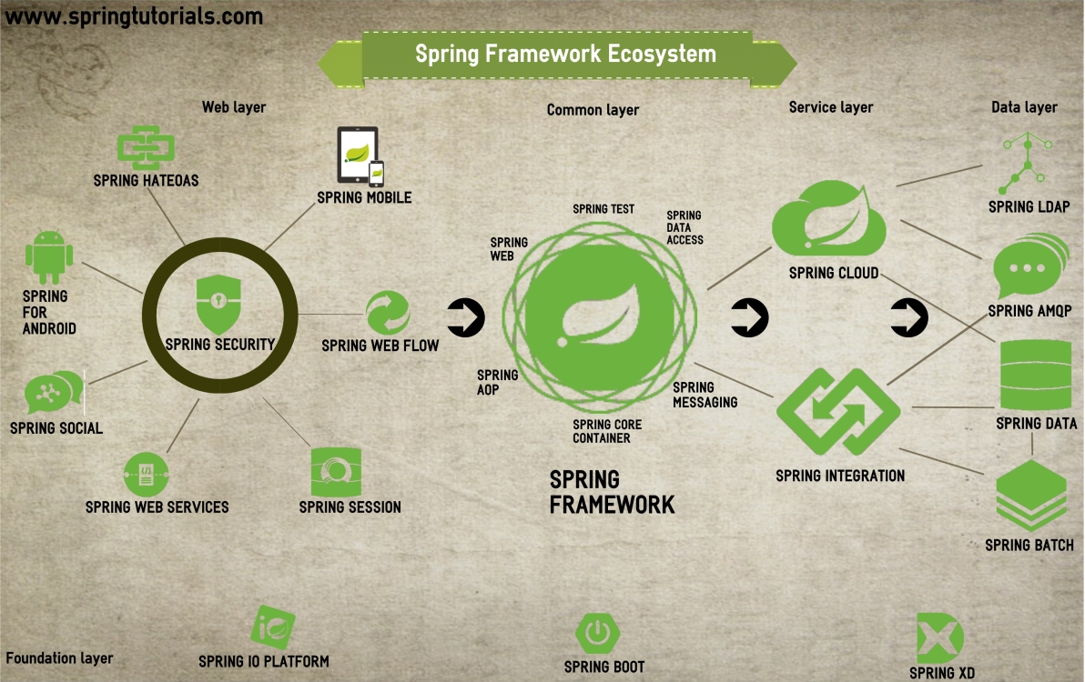
Spring Eco System
Notes:
https://www.youtube.com/watch?v=dXpqA73t3W8
It will show micro view to understand and be able to choose what we want to use further.

Slide 9
Web layer :
Front-End
Web Project can use Spring Security
Spring Security is a framework that control who can interact with your application and at what levels; authentication and authorization, respectively.
Common layer :
Focus on application-level Business logic
Support : DI , Transaction, MVC, JDBC etc to create web app and Restful web services
Service layer :
Spring Cloud provides tools for developers to quickly build some of the common patterns in distributed systems
Spring Integration’s primary goal is to provide a simple model for building enterprise integration solutions while maintaining the separation of concerns that is essential for producing maintainable, testable code.

Slide 10
Data layer
This layer is related to data handling and manipulation.
LDAP : Used to guarantee the authorization
Spring AMQP is related to the use of messages in the systems
Spring Batch is used to makes the programmer's lives easier when they need to work with batch jobs.
Spring Data : Reduce the code by repository and custom object-mapping abstractions and Dynamic Query
Foundation Layer
Spring Boot : Responsible for initial project configuration
Spring XD: For Big Data application
Spring has a big ecosystem that can help your application in several aspects. With a macro view, you can focus on your necessities.
Notes:
https://fabiana2611.github.io/spring/springecosystem

Slide 11
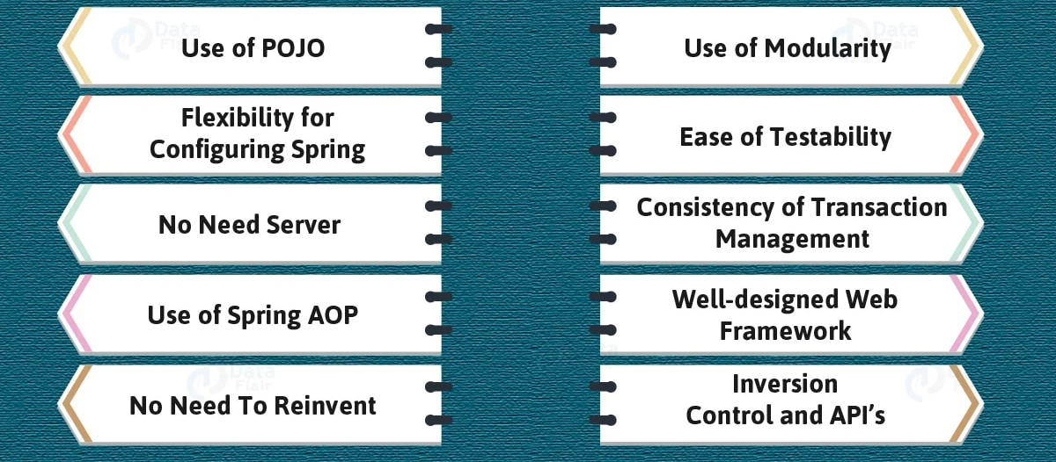
Advantages of Spring
Notes:
i. Use of POJO
Spring Framework helps the developers to develop enterprise application. It uses POJO’s which is an abbreviation for Plain Old Java Object. Using POJO for developing an application is that you don’t need an enterprise container like an application server. Also, it helps you get rid of conventional Enterprise Java Beans (EJB) by letting you can use a robust servlet container like Tomcat. This makes Spring Framework a lightweight framework.
ii. Flexibility for configuring Spring
Spring supports the use of both XML configuration as well as Java-based annotations for configuring the Spring Beans. Therefore, it provides the flexibility of using any of them for developing your enterprise application.
iii. No Need Server
As you know Spring framework provides a lightweight container. This can be activated without the use of the web server or application server.
ad
iv. Use of Spring AOP
The Spring AOP module brings several benefits to the developer. It allows a developer to have different compilation unit or separate class loader. Along with that, it uses IoC for dependency injection which allows aspects to be configured normally. Follow this link to know about Spring LoC Containers in detail.
v. No Need to Reinvent
One of the major benefits of Spring Framework Framework for development of enterprise application is that you can leverage from Spring. Spring uses technologies such as JDK timers, ORM frameworks, Java EE etc. So that developers need not have to learn all those technologies or frameworks in order to develop applications.
vi. Use of Modularity
The Spring Framework provides modularity to the developers. It helps them to choose which packages or classes can be used or ignored. With tons of classes and packages, it comes as a boon to developers to identify and choose the packages or classes without any problems.
vii. Ease of Testability
One the feature of Spring Dependency injection helps in gearing up testability. It simplifies the injection of test data with the use of JavaBean POJO.
viii. The Consistency of Transaction Management
Spring Framework Framework can easily scale up or down the local as well as global transactions using JTA. It is due to consistent transaction management interface. Read More about Spring Transaction Management
ix. Well- Designed Web Framework
Spring has well designed MVC framework which provides a great alternative solution to a legacy web framework. You will learn about Spring MVC Framework integration later in the coming articles.
x. Inversion Control and API’s
Spring Framework provides inversion control and APIs to translate exceptions thrown by JDBC, Hibernate into unchecked and consistent ones.

Slide 12
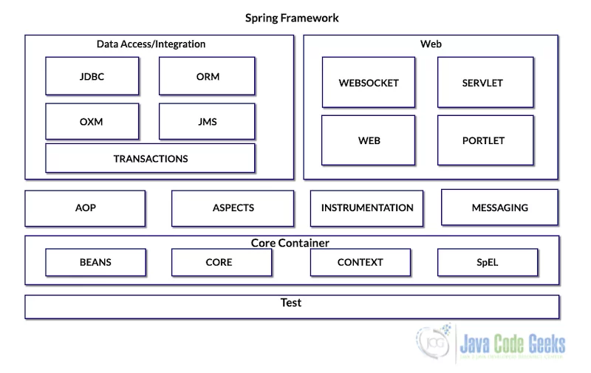
Spring Modules / Architecture
Notes:
Core Container – having the fundamental parts of the framework.
Data Access/Integration – the layer to access databases and transaction modules.
Web – responsible to deal with web-oriented integration such as HTTP connections, Model-View-Controller (MVC) structures and REST Web services.
Miscellaneous – a few other modules but important to know about:
AOP – Aspect-Oriented Programming
Aspects
Instrumentation
Messaging
Test
In summary, Spring Framework has about 20 modules and sub-modules in his architecture.

Slide 13
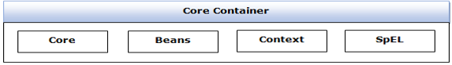
Core Container
Spring Core Module:
Core module of the spring framework
Responsible for the implementation of features like IoC (inversion of control) and dependency injection with a singleton pattern.
Spring Bean Module:
Responsible for providing the implementation of the factory design pattern through the Bean factory.
Spring Context:
This module is a medium for accessing any object defined and configured. This module has been built on the base provided by the core module and Bean module.
Spring Expression Language (SpEL):
The SpEL module is an extension for expressing language support by Java Server pages.
Notes:
This core module is the fundamental module of the framework. This core module tells about how to configure spring beans, their dependencies in the XML file. This core module also provides a Spring Inversion of Control (IOC) container (Spring Container).

Slide 14
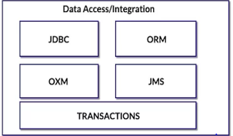
Data Access/Integration
JDBC: Provides a JDBC-abstraction layer that removes the need for tedious JDBC related coding.
ORM: Provides integration layers for popular object-relational mapping APIs, including JPA, JDO, Hibernate.
OXM: Provides an abstraction layer that supports Object/XML mapping implementations for JAXB, Castor, XMLBeans, JiBX and XStream.(Other Framework)
JMS: Contains features for producing and consuming messages.
Transaction: This module supports programmatic and declarative transaction management for classes that implement special interfaces and for all your POJOs.
Notes:
This module is an abstraction layer on top of JDBC technology and ORM tools. This module makes database access simple by avoiding boiler-plate code. Boiler-plate code is a repetitive code. This module of the Spring framework provides some template classes, for reducing boilerplate code problems and also memory leakage problems.

Slide 15
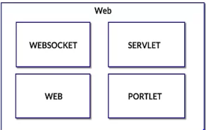
Web and Remote Module
Web :
This module provides basic web oriented features like file uploading functionality, web oriented application environment and initialization of IoC and servlet containers.
Web-Servlet :
This module provides Model-View-Controller (MVC) implementation for web applications.
Web-Portlet :
This module provides MVC implementation to be used in portlet environment.
Notes:
This layer consists of modules which provide us web related features.
This module is for distributed application development using the spring framework. Spring web allows spring developers to integrate Struts with Spring framework or it allows the developer to write MVC application also with Spring framework. Spring remoting tells about how to invoke the services of other beans which are running at some other JVM across the network.

Slide 16
Miscellaneous
AOP:
Provides an aspect-oriented programming implementation allowing you to define method-interceptors and pointcuts to cleanly decouple code that implements functionality that should be separated.
Aspect :
Provides integration with AspectJ, which is again a powerful and mature AOP framework.
Instrumentation :
Provides class instrumentation support and class loader implementations to be used in certain application servers.
Messaging :
Support configurative registration of message objects for message consumption from message queues.
The Test module supports the testing of Spring components with JUnit or TestNG frameworks.

Slide 17

Dependency Injection
It is a design pattern which removes the dependency from the programming code, that makes the Application easy to manage and test.
Dependency Injection makes our programming code loosely coupled, which means change in implementation doesn’t affects the user.
Notes:
Spring has ability inject dependency from other object to other object.
When we give all the controls to Spring for dependency injection at runtime known as Inversion of control.

Slide 18
public class TextEditor {
private SpellChecker spellChecker;
public TextEditor() {
spellChecker = new SpellChecker();
}
}
public class TextEditor {
private SpellChecker spellChecker;
public TextEditor(SpellChecker spellChecker) {
this.spellChecker = spellChecker;
}
}
Dependent
Independent (Dependency Injection)
Notes:
The TextEditor here shouldn’t worry about the implementation of the SpellChecker. Instead, the SpellChecker should be implemented separately and should be provided to the TextEditor while doing the instantiation of the TextEditor. This process is entirely controlled by the Spring Framework Framework. Now after removing the entire control from the TextEditor and then keeping it somewhere else and the Dependency that is SpellChecker is injected into the TextEditor class via a Class Constructor. Therefore, the flow of control is being inverted by the Spring Dependency Injection as you have delegated the dependencies to some external system.

Slide 19
Where Design Pattern useful? Using J2EE
UI Layer
Product Controller
Business/Service Layer
Product Service
Inject
Data Access Layer
Product DAO
DB
Notes:
There are so many layers :
Handle request – UI layer,
UI layer – JSF, Spring MVC
Business layer – Security, Transaction Management
DAL – Spring JDBC, ORM

Slide 20
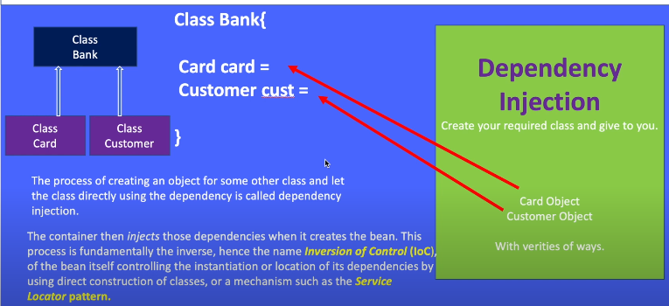

Slide 21
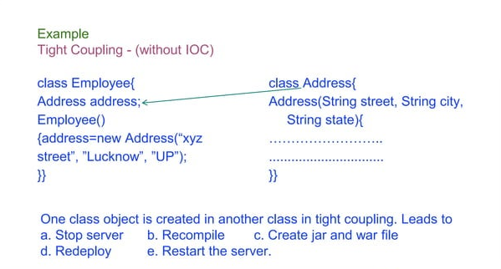

Slide 22
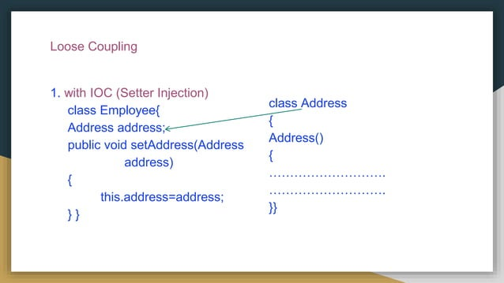
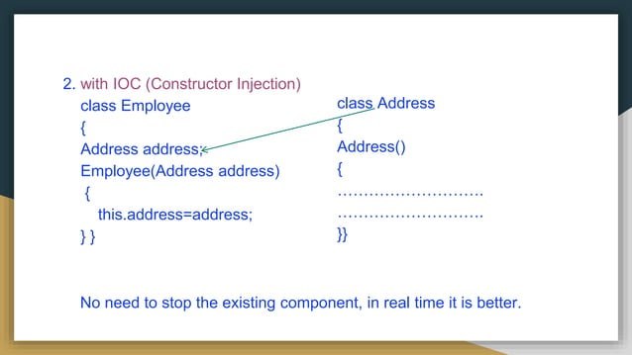

Slide 23
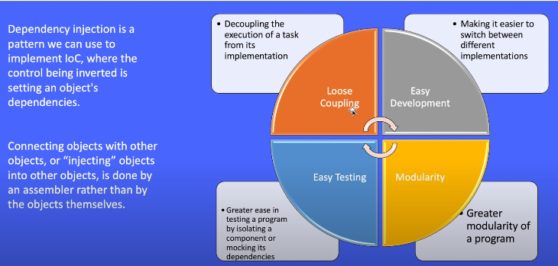
DI Benefits

Slide 24
Inversion of Control
The flow of business logic depends on the statically defined objects and their dependents. This approach creates tightly coupled applications that are hard to extend or modify. But with IOC containers, the business logic depends on the object graph built by an IOC container.
In software engineering, IOC describe a design in which custom-written portions of a computer program receive the flow of control from generic reusable library.
DI is concrete example of IOC.
The spring container is at the core of the spring framework.
The container will create the objects, wire them together, configure them and manage their complete life cycle from creation till destruction.
The Inversion of Control is a process by which application defines the dependency and Spring IoC Container manages these processes as well life cycle of beans.

Slide 25
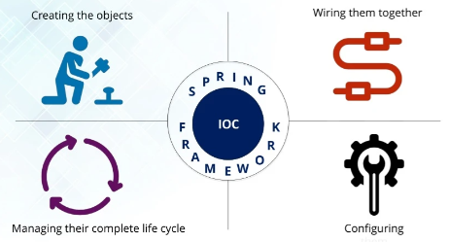
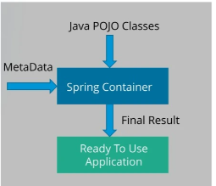
IOC Features
The Spring IOC container by using Java POJO classes and configuration metadata produces a fully configured and executable system or application.

Slide 26
Spring Project “Hello world” Creation using Maven
Create Maven Project with Java Application
Adding dependencies in pom.xml → Spring core , spring context, spring beans . Take it from maven repository.
Create beans -> Java class
Crete configuration file -> SpringConfig.xml in resource folder and add bean tag in in that.
Create Test class in that main method create container and call bean object.

Slide 27
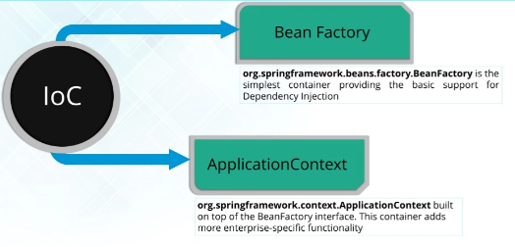
Spring IOC container
Spring Framework provides two Java Interfaces, that works as Spring Containers.
Notes:
https://www.dineshonjava.com/spring-ioc-container/

Slide 28
Bean Factory
It supports only XML configuration.
It comes under package org.springframework.beans.
Known as legacy container.
Since we can’t create an object from an Interface in Java, the BeanFactory interface provides a most commonly used implementation class which is XmlBeanFactory.

Slide 29
Application Context
It supports all the forms of configuration: XML, Java and Annotation.
It comes under package org.springframework.context.
It provides multiple implementation classes such as:
(A) ClassPathXmlApplicationContext : We should use it when configuration file is at project’s class path.
(B) FileSystemXmlApplicationContext : We should use it when configuration file is at server’s file system.
(C) AnnotationConfigApplicationContext : We should use it when we are using annotation-based configuration.

Slide 30
How to Create container?
ApplicationContext is the most widely used and BeanFactory is rarely used
ApplicationContext context = new ClassPathXmlApplicationContext("com/dev/spring/example/config.xml");
For Annotation-based configuration:-
AnnotationConfigApplicationContext context = new AnnotationConfigApplicationContext(AppConfig.class);

Slide 31
How to get Bean from spring container?
Using getBean() method : Have multiple variant
ApplicationContext ctx = new ClassPathXmlApplicationContext("com/dev/spring/example/config.xml");
Person person = ctx.getBean(“p”,Person.class);
System.out.println(person);

Slide 32
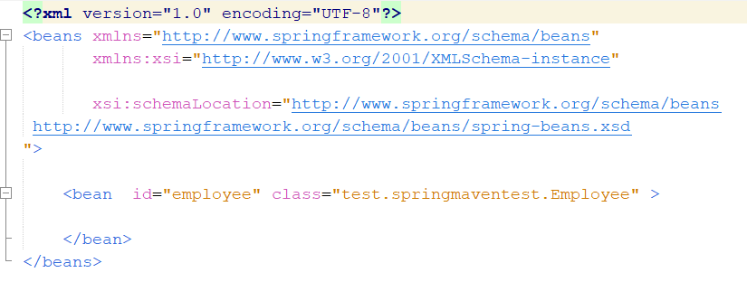
How to configure metadata?
Configuration metadata represents how you as an application developer tell the spring container to insatiate, configure, assemble the objects in your application.
XML based configuration metadata:
Notes:
If these details are specified in configuration files which are in XML format, it is known as XML-based configuration. These configuration files usually contain a lot of bean definitions and other required application-specific configuration options. They generally start with a bean tag. All configurations can be in one or multiple XML files. For example, below code snippet demonstrates the XML-based configuration.

Slide 33
How to pass setter data?
<bean id="employeeBean" class="com.dev.spring.EmployeeBean">
<property name="name" value="employee1"/>
<property name="age" value="24"/>
</bean>

Slide 34
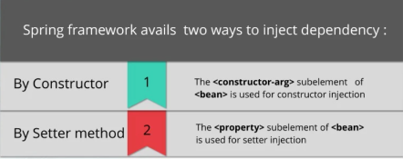
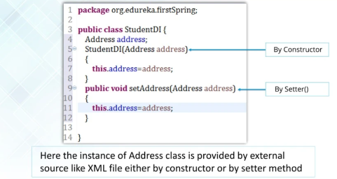
Dependency Injection Types:
By constructor : Container will invoke a constructor with arguments each representing a dependency we want to set.
By Setter method : Container will call setter methods of a class.
Injecting Object (Setter Injection)
Injecting Object (Constructor Injection)- Has a relationship in class.
Collection injection – array, list, hashmap, map, linkedlist, arraylist
Demonstration of each Dependency injection.
Notes:
https://www.javatpoint.com/dependency-injection-in-spring

Slide 35
What inputs spring container wants?
Spring Bean
Spring Configuration – Configuration Metadata
Configuration can be done in 3 ways:
XML-based Configuration
Java-based Configuration
Annotation-based Configuration
Notes:
Create Project Helps :
https://javatechonline.com/spring-core-tutorials/#Java-based_Configuration

Slide 36
XML based Configuration
In Spring Framework, developer defines the bean name, dependencies and the other services needed by Spring Container. If these details are specified in configuration files which are in XML format, it is known as XML-based configuration.
Eg :
<bean id="employeeBean" class="com.dev.spring.EmployeeBean">
<property name="name" value="employee1"/>
<property name="age" value="24"/>
</bean>

Slide 37
Annotation based Configuration
Spring 2.5 introduces annotation-based configuration.
By default, annotation wiring is not turned on in the Spring framework.
So, in order to use annotation-based configuration, we need to enable it before using it by specifying <context:annotation-config/> tag .
Once this tag is configured, we can start annotating our code.
<beans>
<context:annotation-config/>
<!-- bean definitions go here -->
</beans>
@Component, @Controller, @Service, @Repository etc. Most of the time we apply @Component annotation as it is the basic annotation. However, other annotations have some specific purpose.
Notes:
Since Spring Boot has reduced the use of XML configurations, we don’t need to follow this step in Spring Boot Application. We can directly use annotations whenever it is required.

Slide 38
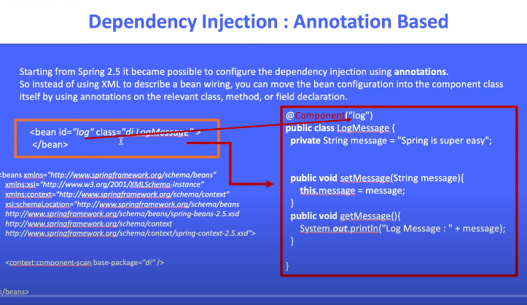

Slide 39
Java Based Configuration
With Spring 3.0, a pure-Java configuration container was provided.
No need for XML configuration.
Supported annotations are : @Configuration , @Bean annotated methods
@Configuration annotation represents that Spring container will use it as a source of Beans definitions
@Bean tells Spring container that method will return an object which should be registered as a bean in Spring application context.
@Bean annotation plays the same role as the <bean/> element.
2. @Configuration classes allow define inter-bean dependencies by simply calling other @Bean methods in the same class.
@Configuration
public class EmployeeConfig{
@Bean
public EmployeeBean permanentEmployee(){
return new EmployeeBean();
}
@Bean(name="contractEmployee")
public EmployeeBean otherEmployee(){
return new EmployeeBean();
}
}

Slide 40
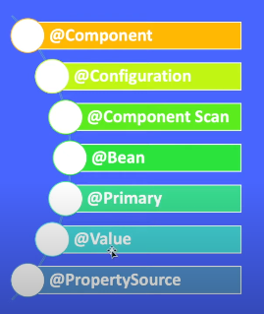
Annotations used :
Notes:
https://www.youtube.com/watch?v=i0i5yntyZ5g

Slide 41
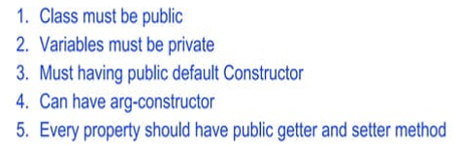
Beans
In Spring, the objects that form the backbone of our application and that are managed by the Spring IoC container are called beans.
A bean is an object that is instantiated, assembled, and managed by a Spring IoC container. Otherwise, a bean is simply one of many objects in your application.
Beans, and the dependencies among them, reflect in the configuration metadata used by a container.
Bean definition contains the information called configuration metadata, which is needed for the container to know :
How to create a bean
Bean’s life cycle
Bean’s dependencies

Slide 42
Spring Bean is a class in spring, which follows the rules provided by the Spring Container.
Rules :
1) Class must be public.
2) Variables are recommended to be private.
3) Methods should be public.
4) Class should be under a package. It can be either under a base package or its sub package.
5) Provide any one of the two combinations given below. There is no harm in providing both of them, but any one will be sufficient.
(A) Default constructor with setter & getter methods
(B) Parameterized constructor
6) Class can extend or implement only those classes or interfaces which are part of Spring Framework’s API. We can identify classes and interfaces from Spring Framework API by finding their package names. They come under package org.springframework.
7) Class can override 3 methods from Object class: toString(), hashcode() and equals().
8) Class can implement java.io.Serializable interface.
9) Class can use Core Java Annotations, Spring Framework Annotations, and some Integration Annotations.
Core Java annotations comes under package java.lang, such as Deprecated,
Override, SafeVarargs, SupressWarnings. Integration annotations are used in very rare cases.

Slide 43
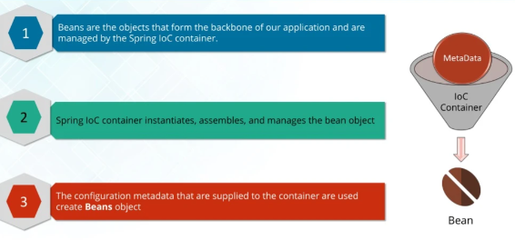
Bean Object

Slide 44
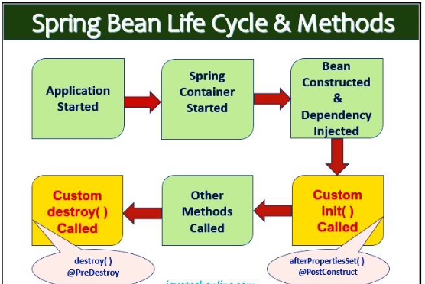
Bean Life cycle
2 important methods :
Public void init() and Public void destroy()
Bean life cycle is managed by the spring container.
When we run the program then the spring container gets started.
Then container creates the instance of a bean as per the request, and then dependencies are injected.
Finally, the bean is destroyed when the spring container is closed.
Therefore, if we want to execute some code on the bean instantiation and just after closing the spring container, then we can write that code inside the custom init() method and the destroy() method.
We can change name of method but signature must remain same.
init(): If we want to initialize anything such as loading some configurations, creating database connections, we can write that code in init() method.
destroy(): If we want to cleanup something such as closing database connections, we can write that code in destroy() method.
Notes:
https://www.dineshonjava.com/understanding-bean-scopes/
https://learncodewithdurgesh.com/course/spring-framework-tutorial-learn-code-with-durgesh/221

Slide 45
Life cycle achievement
Interface-based Lifecycle Management can be achieved by implementing
InitializingBean and DisposableBean interfaces
Method-based Lifecycle Management is achieved by adding custom init() and destroy() methods in the bean class and declaring them in the bean configuration file.
Annotation-based Lifecycle Management is achieved by adding JSR-250 @PostConstruct and @PreDestroy annotated methods in the bean class.
Method-based Demo :
The local init() and destroy() methods can be configured to a specific bean as in the given XMl Configuration example.
<beans>
//...
<bean id="demoBean" class="com.howtodoinjava.task.DemoBean"
init-method="customInit"
destroy-method="customDestroy"></bean>
//...
</beans>
Registering a Shutdown Hook is Necessary. So use AbstractApplicationContext for retrive container. Use
Context.registerShutdownHook();
Notes:
https://howtodoinjava.com/spring-core/spring-bean-life-cycle/
https://medium.com/@sendvjs/spring-bean-life-cycle-9363332c335e – All ways example

Slide 46
Bean Scope
Singleton: Only one instance will be created for a single bean definition per Spring IoC container and the same object will be shared for each request made for that bean.
Prototype: A new instance will be created for a single bean definition every time a request is made for that bean.
Request: A new instance will be created for a single bean definition every time an HTTP request is made for that bean. But Only valid in the context of a web-aware Spring ApplicationContext.
Session: Scopes a single bean definition to the lifecycle of an HTTP Session. But Only valid in the context of a web-aware Spring ApplicationContext.
Global-Session: Scopes a single bean definition to the lifecycle of a global HTTP Session. It is also only valid in the context of a web-aware Spring ApplicationContext.
Notes:
https://mkyong.com/spring/spring-bean-scopes-examples/

Slide 47
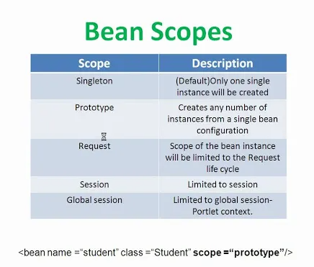

Slide 48
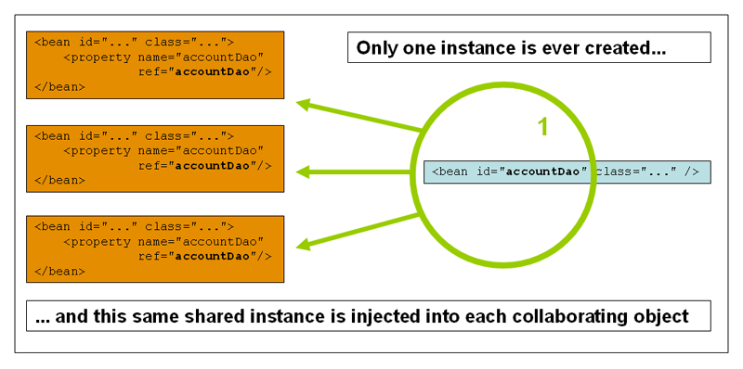
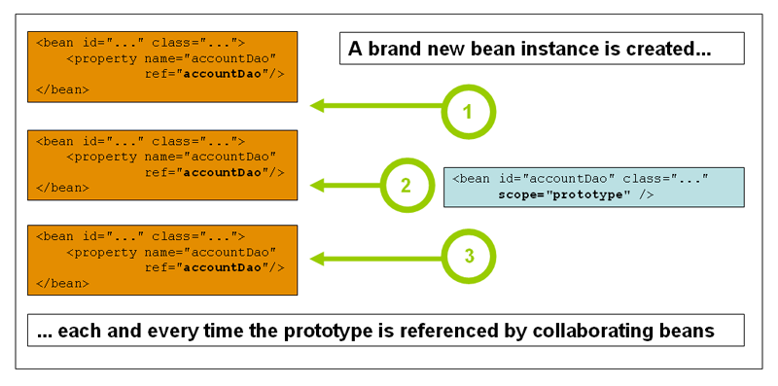
The request, session, application, and websocket scopes are available only if you use a web-aware Spring ApplicationContext implementation (such as XmlWebApplicationContext)

Slide 49
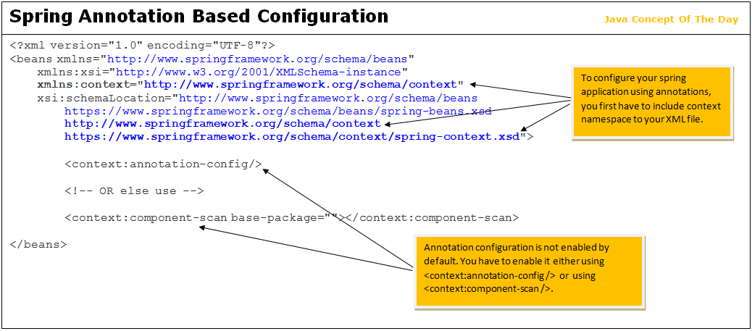

Slide 50
Spring Annotation Based configuration
<context:annotation-config /> tag detects all dependency injection related annotations like @Autowired, @Qualifier, @PostConstruct, @PreDestroy, @Resource etc…
<context:component-scan /> tag detects both bean related annotations like @Component, @Repository, @Service, @Controller, @RestController, @Configuration etc… as well as dependency injection related annotations

Slide 51
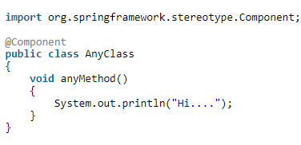
@Component annotation is a class level annotation used to indicate that the following class as a component.
Classes declared with @Component annotation are auto-detected by spring, a single instance is created of such classes at the application start-up by passing the possible dependencies and that instance is used wherever required.
No need to mention component classes in the XML file using <bean> tag. They are auto-instantiated at the start-up and you can use them in your application context.
Notes:
https://javaconceptoftheday.com/spring-annotation-based-configuration/

Slide 52
Auto wiring
Auto wiring is method of creating an instance of an object and "by concept" injecting that instance on a specific class that uses it.
We need not to inject manually in xml as we did previously.
Automatically it detects where to get injected.
2 WAYS :
1. By using autowire attribute in xml in <bean> tag
autowire byName – For this type of autowiring, setter method is used for dependency injection. Also the variable name should be same in the class where we will inject the dependency and in the spring bean configuration file.
autowire byType – For this type of autowiring, class type is used. So there should be only one bean configured for this type in the spring bean configuration file
autowire by constructor – This is almost similar to autowire byType, the only difference is that constructor is used to inject the dependency.
Notes:
https://www.jbktutorials.com/spring-ioc/auto-wiring-in-spring-ioc.php#gsc.tab=0

Slide 53
2. @Autowired Annotation
@Autowired annotation – We can use Spring @Autowired annotation for spring bean auto wiring.
For @Autowired annotation to work, we also need to enable annotation based configuration in spring bean configuration file. This can be done by context:annotation-config element.
Need to add this in config file
xmlns:context=http://www.springframework.org/schema/context
Add this in to Schema location :-
http://www.springframework.org/schema/context
http://www.springframework.org/schema/context/spring-context.xsd
@Autowired annotation is used for automatic injection of dependencies into a component class.
@Autowired on Constructor:
@Autowired with Arugments: By default,dependency is required in the case of @Autowired like @Required but you can turn off it by passing required=false to @Autowired as argument.
@Autowired on setter methods: By default,whereever spring containers finds @autowire notation,it autowires bean byType
Notes:
Example : https://java2blog.com/autowired-annotation-in-spring/

Slide 54
Stereotype Annotations @Component and Component-Scan and @Value
Stereotype annotations are special annotations that define a class's role in a Spring application. They come in handy to improve configuration simplicity and boost readability.
@Component, @Repository, @Service, and @Controller
With these annotations in place and automatic component scanning enabled, Spring will automatically import the annotated classes as beans into the application context and inject them into dependencies.
@Component
public class EmployeeDAOImpl implements EmployeeDAO { ... }
It will only scanned and configured if you have specified <context:component-scan base-package=" " />
Starting point for a recursive component search.
Spring @Value annotation is used to assign default values to variables and method arguments.
Notes:
https://learncodewithdurgesh.com/course/spring-framework-tutorial-learn-code-with-durgesh/233

Slide 55
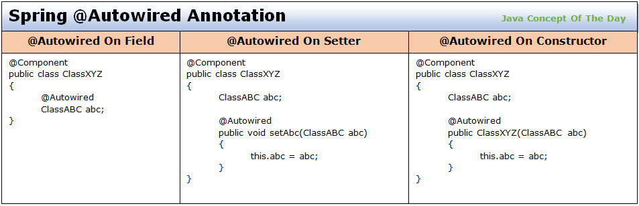
By default, spring auto-wires the components by type. If there are more than one bean available of the same type, spring faces the ambiguity and throws an exception. To avoid the ambiguity while auto-wiring, @Qualifier is used to tell the spring which bean to use. In this post, we will see how to use spring @Qualifier annotation with an example.
Notes:
https://javaconceptoftheday.com/spring-autowired-annotation-with-example/
https://java2blog.com/spring-autowiring-byname/

Slide 56
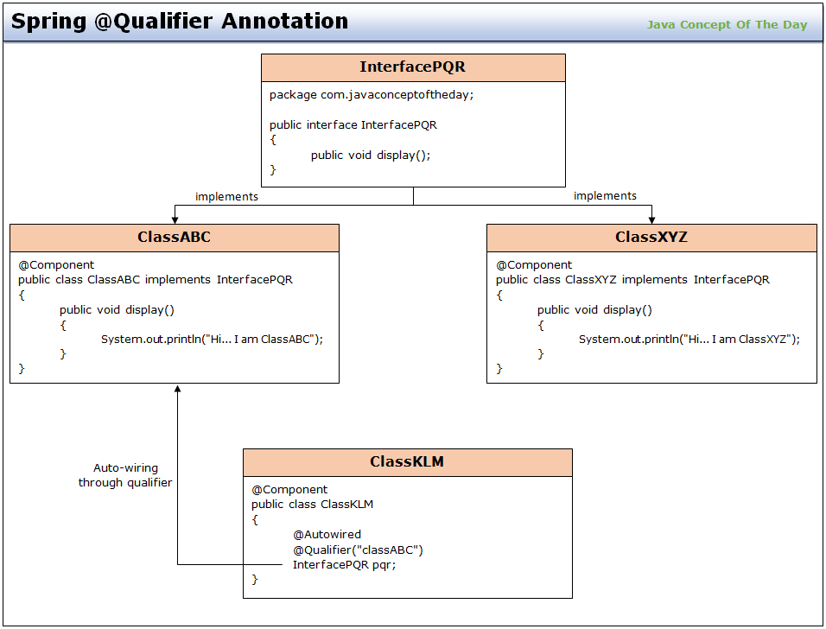
@Qualifier
Spring @Qualifier annotation is used to eliminate the ambiguity of which bean to use if there are multiple beans of same type are available in the container.

Slide 57
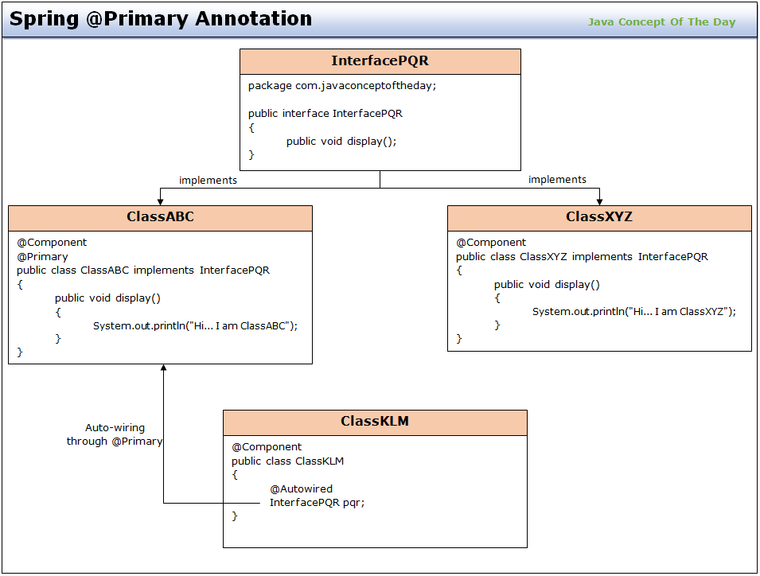
@Primary
@Qualifier annotation is used to specify which bean to use when there are multiple beans of same type are available in the container while auto-wiring.
@Primary annotation is also used for same purpose but it specifies the highest preferred bean when there are multiple beans of same type are available in the container while auto-wiring.

Slide 58
Java Based Configuration
In an XML based configuration, all configurations are done using an XML file.
In annotation based configuration, all configurations are done using annotations but your configurations to work, you have to enable them in an XML configuration file.
In Java code based configuration, we never use any XML file.
Configurations are done purely using annotations and Java code.
@Configuration And @Bean Annotations
@Configuration is a class level annotation used to indicate that following class can be used by the spring container to configure an application.
A class annotated with @Configuration contains bean definition methods which return beans. These bean definition methods are declared with @Bean annotation.
@Bean annotation is a method level annotation used to indicate that following method returns a bean.

Slide 59
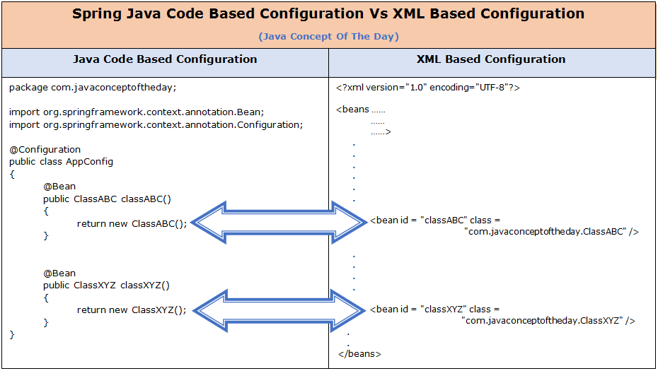
Notes:
https://javaconceptoftheday.com/spring-java-code-based-configuration/

Slide 60
Must Do:
Use of Standalone Collection using Util Schema
Notes:
Standalone collection : - https://learncodewithdurgesh.com/course/spring-framework-tutorial-learn-code-with-durgesh/232

Slide 61
Reference
Road Map : https://www.youtube.com/watch?v=ff-mHzhWXBU
Notes:
https://www.youtube.com/watch?v=ff-mHzhWXBU

